Slide 1
Purchasing commodity prediction system
Liu Chenru
1501213463

Slide 2
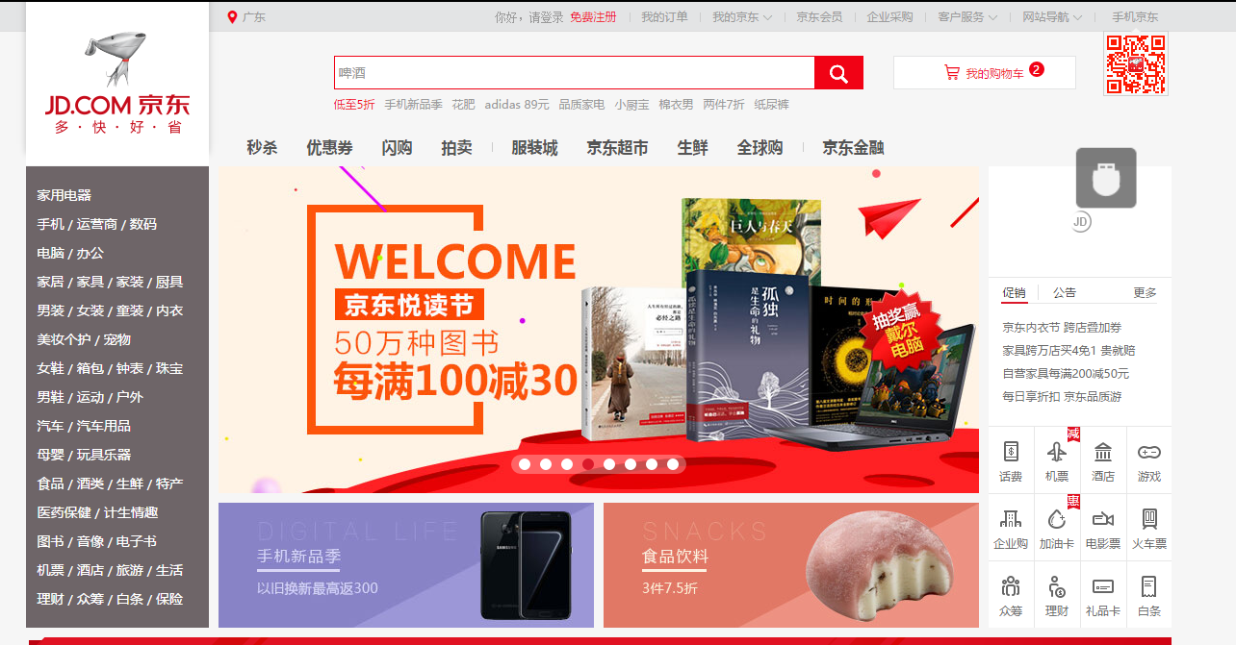
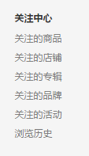

Data source

Slide 3
Data Description
User Info
User_id | ID for user
Age | -1 : no info
Sex | 0: male, 1: female 3: no info
User_lv_cd | the user class
User_reg_dt | User registration date
Product Info
Sku_id | Product ID
Attr1 | Enum type
Attr2 | Enum type
Attr3 | Enum type
brand | Brand ID

Slide 4
Data Description
Action Info
User_id | ID for user
Sku_id | ID for product
Time | The time of action
Model_id | The module that user click
Type | The type of action: Browse Add to shopping list Delete from the shopping list Purchase Add the product to the interest list click
Cate | Class ID
Brand | Brand ID

Slide 5
Data Analysis
Our purpose is to use our information to predict whether the user will buy commodity in next five days and what he will buy next five days.
There are three type of information: user information, product information, action information. But For specific product or user, we have little information.
We will mainly focus on the action information, we will use action information to extract features for every product and user.

Slide 6
Feature Description
User feature
Num1TU—Num6TU | The number of specific type of action
UIntNum | The number of total action for user
UInt1-UInt3 | The number of product that user only interact with for 1 time, 2 times, 3 times
UClick1 | The number of product that user only click at once
UPNum | The number of product that user have interactions with
Num1PU-Num6PU | The average number of specific action for each user
IntPU | The average number of total action for each user
1to4UR—6to4UR | Num4TU/Num1TU

Slide 7
Feature Description
Product feature
Num1TP—Num6TP | The number of specific type of action
PIntNum | The number of total action for product
PInt1-PInt3 | The number of user that product only interact with for 1 time, 2 times, 3 times
activeUNum | The number of user who have click at the product at least three times
buyMoreNum | The number of user who have buy more than 1 time
visitUNum | The number of user who have browsed this product
PUNum | The number of the user who have interaction with the product.
PClick1 | The number of user that only click at the product once
buyUNum | The number of user that product have interactions with
Num1PP-Num6PP | The average number of specific action for each product
IntPU | The average number of total action for each product
1to4PR—6to4PR | Num4TP/Num1TP

Slide 8
Feature Description
Time feature
1First-6First | The first day that user and product have specific action
first | The first day that user and product have interaction
1lastt-6last | The last day that user and product have specific action
last | The first day that user and product have interaction
Day1-day6 | The number of days that user and product have specific action
InterDays | The number of days that user and product have interactions
ItDayR | The number of days that user and product have interactions/Total days
It2BuyR | The number of days that user and product have interactions/Buy Num

Slide 9
Feature Analysis
We will transfer our question into a classification problem: whether the user will buy the specific product or not? So our output is 0(not buy) or 1(buy)
The key in this problem is (user_ID, product_ID)

Slide 10
Correlation Analysis
We compute the correlation of each feature with the final result. Then we find the most important feature:
Num1, Num2, Num5, Num6, day1, day2, InterDays, 2First, 2Last
However, they have higher correlation because of the sparse data

Slide 11
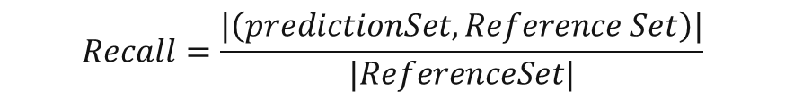

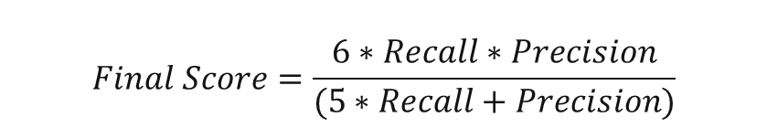
Evaluation Indicators
$$precision=\frac{|\left(predictionSet, Reference Set\right)|}{|PredictionSet|}$$
$$Recall=\frac{|\left(predictionSet, Reference Set\right)|}{|ReferenceSet|}$$
$$Final Score=\frac{6∗Recall∗Precision}{(5∗Recall+Precision)}$$

Slide 12
Model Analysis
The most effective model is Decision Tree model
The logistic and SVM did not work fine may be because our problem is not linear
The KNN did not work fine may be because our data is highly sparse, which means that the purchasing data is relatively rare compared with the total data volume.
The most surprising thing is that in this case the Random Forest worked worse than decision Tree.

Slide 13
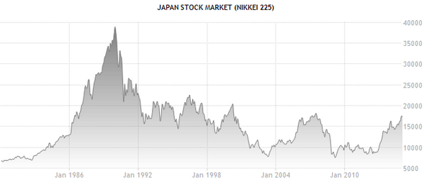
Thank you for your attention!
Source: www.tradingeconomics.com

